Slide 1

COMM223 Marketing Management
Lecture 7 – Product II

Slide 2
Agenda
New product development
Why new product
Stages of new product development
Product life cycle

Slide 3
Where are we now …
Company
Company Analysis
Competitor Analysis
Consumer Analysis
Marketing Management
Competitor
Consumer
Product
Promotion
Price
Distribution
Product - Market

Slide 4

Why New Products?
Two Major Challenges:
Developing new products to replace aging ones
Life-cycle strategies
Adapt to changing tastes, technologies, and competition, as products pass through the life-cycle stages.
Importance also based on:
Growth for companies
Remaining competitive
Keeping up with technological change
Changing consumer tastes
Following market trends

Slide 5
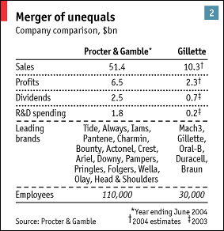
New Product Development: Definition
Defining NPD:
The development of original products, product improvements, modifications, and new brands, through the firm’s own R&D efforts
Two Sources of New Products:
Acquisition: company, patent, license
New product development
3M Company
60,000 employees and 60,000 products
200-300 new products every year

Slide 6
New Product Development
Expensive and risky with high failure rates
60% for new consumer packaged products
66% for new product concepts are never launched
Possible reasons
Market size was overestimated
Actual product was not designed as well as it should have been
Incorrectly positioned in the market
Priced too high
Advertised poorly
Costs of NPD were higher than expected
Competitors fighter harder than expected
The challenge is to overcome the high rate of new product failure

Slide 7
New product development strategy
Developing new products through the firm’s own research and development efforts
Creating successful new products requires
Understanding consumers, markets, and competitors
Developing products that deliver superior value to customers

Slide 8
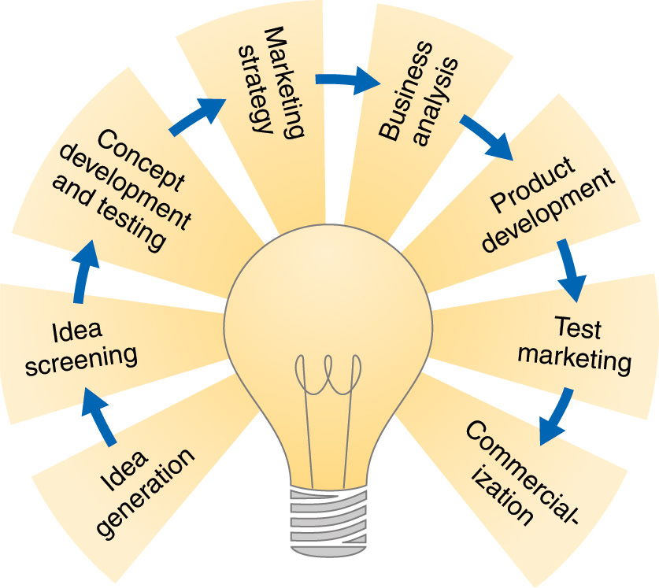
Major Stages in New Product Development

Slide 9
Stages of the New Product Development Process
Stage 1: Idea Generation
The systematic search for new product ideas
Internal sources: brainstorming, employees from all departments, R & D
External sources: customers, competitors, distributors, suppliers, and others.
Crowdsourcing: inviting broad communities of people – customers, employees, independent scientists and researchers, and even the public at large – into the new product innovation process

Slide 10

Intuit, a marketer of financial software, asks for new product ideas from customers

Slide 11
Stages of the New Product Development Process
Stage 2: Idea Screening
The purpose is to identify good ideas and drop poor ones to avoid spending any more money on developing them
Criteria used:
Is it real? real need and desire for the product
Can we win? Competitive advantage; resources
Is it worth doing? Fit company’s growth strategy; sufficient profit potential

Slide 12
Stages of the New Product Development Process
Stage 3: Concept Development and Testing
Concept development creates a detailed version of the idea stated in meaningful consumer terms.
Concept testing: testing new product concepts with a group of target consumers to find out if the concepts have strong consumer appeal.

Slide 13
Stages of the New Product Development Process
Stage 4: Marketing Strategy Development
Designing an initial marketing strategy for a new product based on the product concept.
1st statement describes the target market, product positioning, and sales, market share, and profit goals for the first few years.
2nd statement outlines the product’s price, distribution, and marketing budget for the first year.
3rd statement describes the long-run sales and profit goals, and the marketing mix strategy.

Slide 14
Stages of the New Product Development Process
Stage 5: Business Analysis
Review of the sales, costs, and profit projections for a new product to determine if they will satisfy company objectives
Stage 6: Product Development
Developing the product concept into a physical product to ensure that it can be done
Requires large investment
Building a prototype
Testing for safety, durability, and acceptability

Slide 15
Stages of the New Product Development Process
Stage 7: Test Marketing
Testing the product and marketing program in realistic market settings
The amount of test marketing needed varies with each new product
Gives the marketer an experience with marketing a product before full introduction
Testing takes time, and costs can be high.
Alternatives to standard test markets
Controlled test markets
Simulated test markets
Reasons for using alternative test markets
Reducing the costs
Speeding up the process

Slide 16
Stages of the New Product Development Process
Stage 8: Commercialization
Introducing a new product into the market
Large investment required
Considerations for launching a new product
When to launch
Where to launch
Single location, region, national market, or international market

Slide 17
Managing New-Product Development
Customer-centered new product development
Focusing on finding new ways to solve customer problems and create more customer-satisfying experiences
Team-based new product development:
Various company departments work closely together, overlapping the steps in the product development process to save time and increase effectiveness.
Systematic new product development

Slide 18
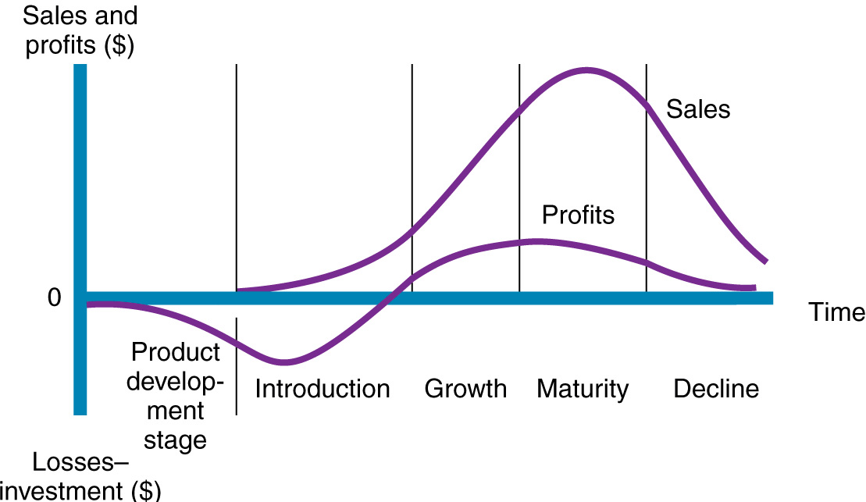
Product Life-Cycle Strategies
Product life cycle (PLC): the course of a product’s sales and profits over its life
The PLC can describe a product class, form, or brand
Not all products follow this exactly
Competition and rate of technology change can influence the length of a PLC
Useful for planning purposes

Slide 19
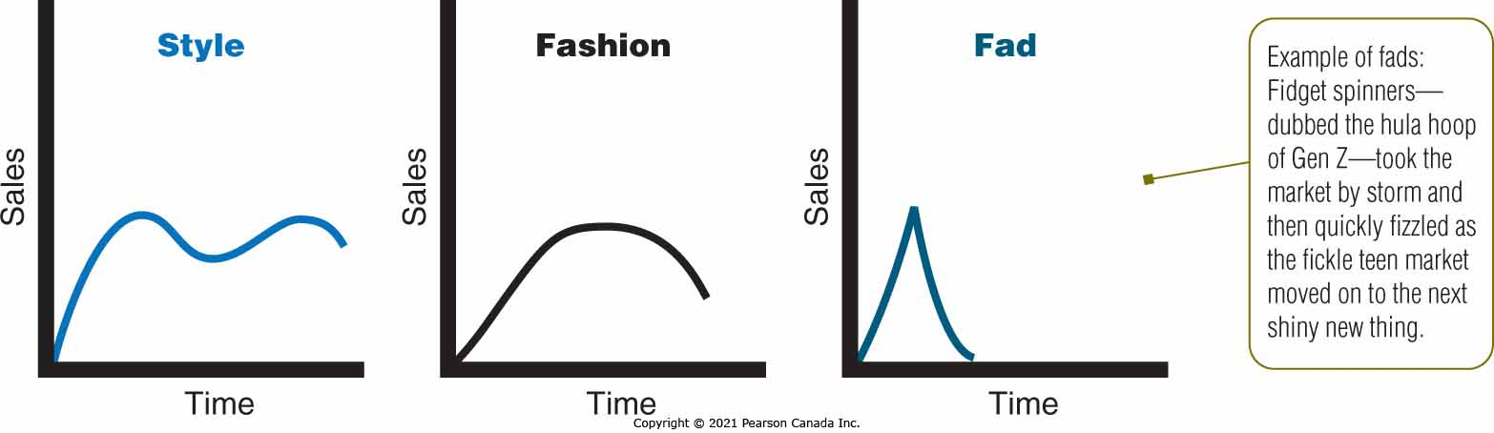
Alternative product life cycles

Slide 20

Product Development Stage
The stage where the product is being developed, as discussed
Sales are zero, profits are negative which is the money spent on development
Products will vary in development costs; eg. pharmaceuticals
Products should meet a need that is not being addressed in the marketplace
The marketing mix is still to be determined
There is no competition at this point
Length of time in this stage will vary by product

Slide 21
Introduction Stage
The new product is introduced to the market
Sales start at zero and begin to climb slowly; profits continue to decline due to costs of launching the product
The main promotional goal is to make a big noise to attract attention and to educate buyers about the new product concept
Market pioneers take the most risk but may reap the biggest rewards
Few product variants, few competitors
Pricing strategy: skimming or penetration
Distribution: not all outlets covered as some may not want the risk

Slide 22
Growth Stage
Sales of the new product begin to climb quickly as awareness within the target market(s) builds
Profits may become positive as development and launch costs are recovered and the company achieves economies of scale
Competition notices and rushes their versions into production
Product quality can be improved, extra features and versions developed to sustain growth and differentiate from competition
Distribution increases as the product becomes more known
Pressure on pricing as competition increases

Slide 23
Maturity Stage
Sales of the new product continue to climb and then peak as the majority of the target market(s) have tried the product
Profits continue to grow and stay positive throughout
Competition is most intense at this stage; many versions and brands
Strategies to prolong this stage:
Modify the market
Modify the product
Modify the marketing mix
Some products stay in this stage for an indefinite period
Others are replace by new technology and fade rapidly

Slide 24
Decline Stage
Sales of the new product drop quickly as the target market(s) move on to other things
Profits decline as competitive pressures force lower prices
Competition has declined as weaker brands have left the market
Companies need to make decisions about what to do with the declining product
Maintain spending levels to fight it out for what is left
Harvest by cutting spending and riding it out
Drop the product and move on to the next thing

Slide 25
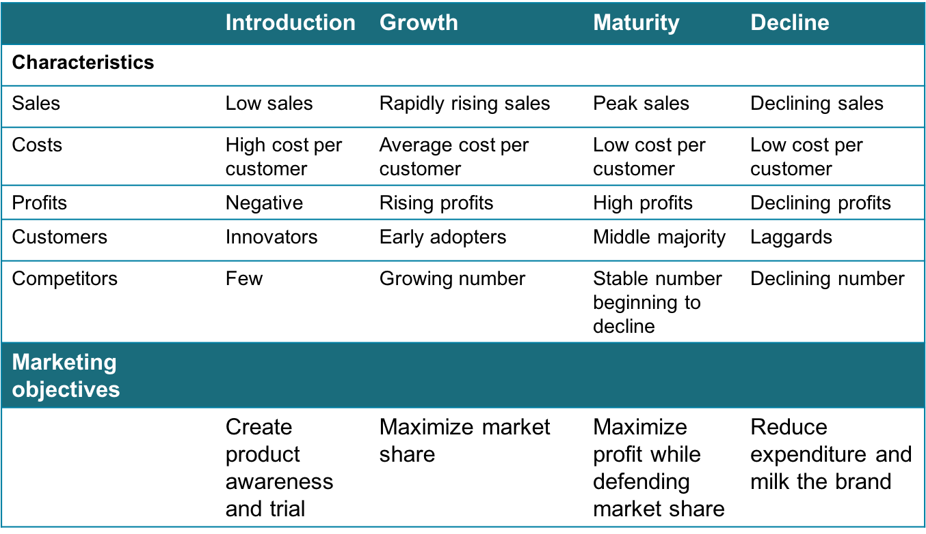
Summary of product life-cycle

Slide 26
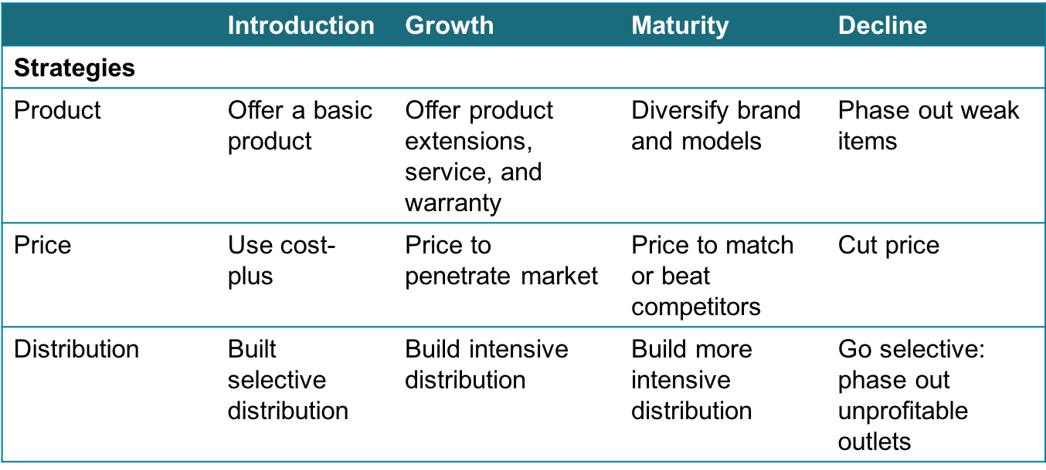
Summary of product life-cycle

Slide 27
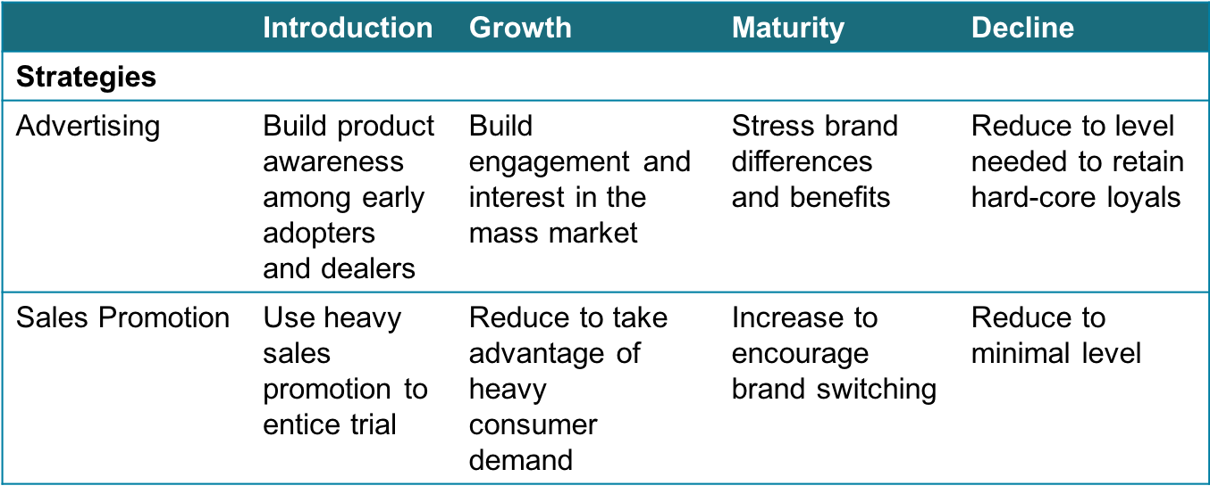
Summary of product life-cycle

Slide 28
Problem of Using PLC
Hard to identify which stage of PLC the product is in
Difficult to forecast the sales level, the length of each stage, and shape of the PLC
Strategy is both a cause and a result of the PLC

Slide 29

Which stage of the PLC? How do you know?
Product development
Introduction
Growth
Maturity
Decline

Slide 30
Discussion
Which product life-cycle stage, if any, is the most important? Which stage is the riskiest? Which stage offers the greatest profit potential? Why?
The most important stage:
The highest risk stage
The greatest profitable stage:

Slide 31
Read Chapter 9

